Slide 1

CAF Hackathon Advanced
Session 2 – Enrollment, Identy and Management Groups

Slide 2
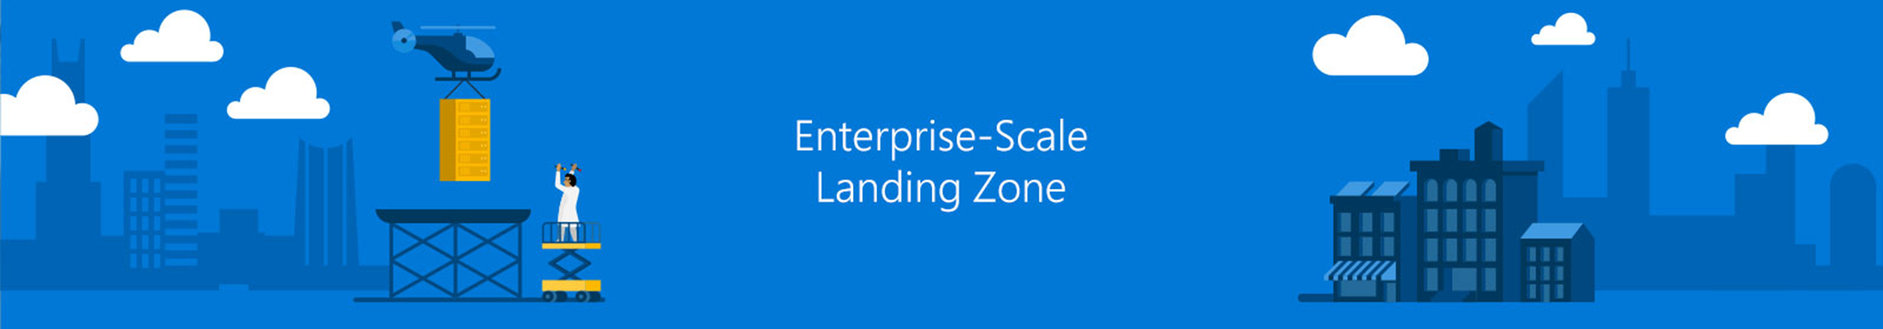
Critical Design Area – Enrollment & Tenant
Notes:
Sarah

Slide 3

Enterprise Agreement & Enrollment
Why do we talk about this?
Notes:
Niels: I thought this was a technical architecture, why do we talk about this?
Sarah:
Technical Dependencies due to role concept, ability to create subscriptions manually and programmatically and secure Azure in enterprise context.

Slide 4
Enterprise Agreement & Enrollment
Enterprise Agreement:
Contract that combines cloud services and software licenses within one agreement
Enrollment:
Server & Cloud Enrollment under the Enterprise Agreement allows to buy Azure or other server technologies
Azure Enterprise Portal (ea.azure.com):
Portal to manage all Server & Cloud enrollments that you have access to.
What about Microsoft Customer Agreement (MCA) or Cloud Solution Provider (CSP)?
There is not yet guidance on these within Enterprise-Scale
Notes:
Sarah
Die meisten Unternehmenskunden verwenden derzeit noch das Enterprise Agreement

Slide 5
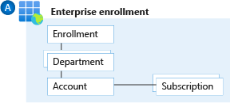
Enrollment Hierarchy Options
Map organizational structure to enrollment hierarchy
Notes:
Sarah
Screenshot zum EA Portal

Slide 6
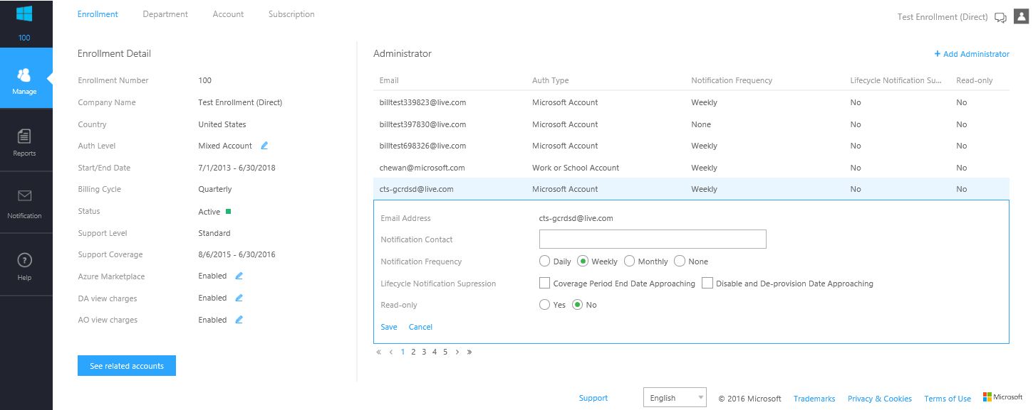
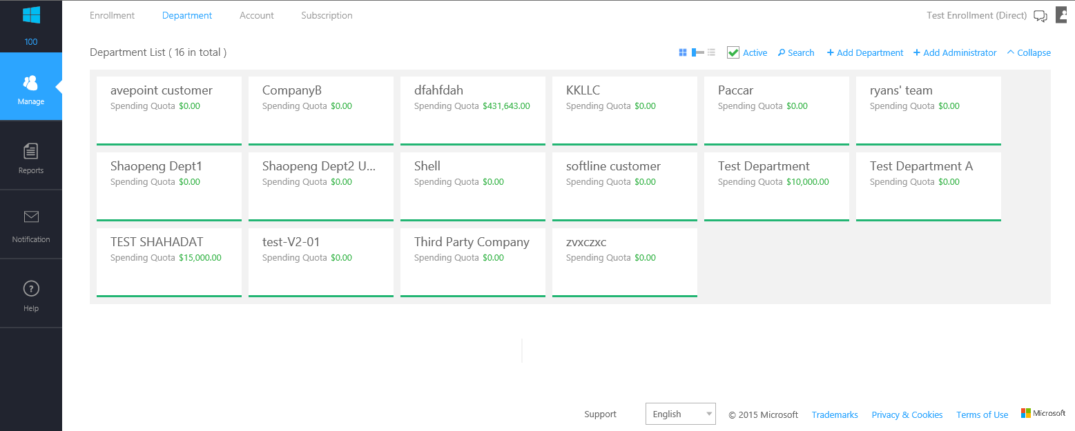
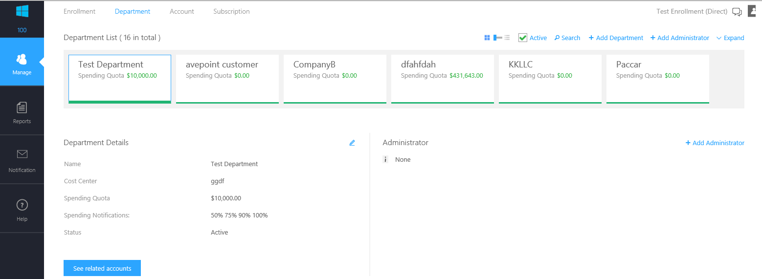
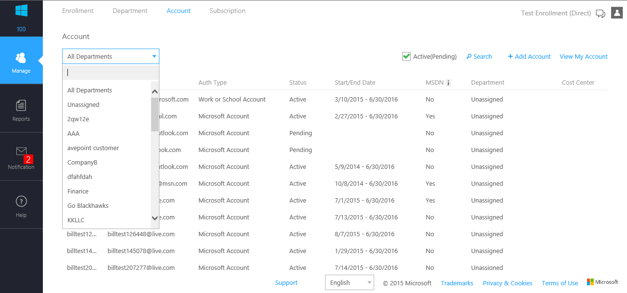
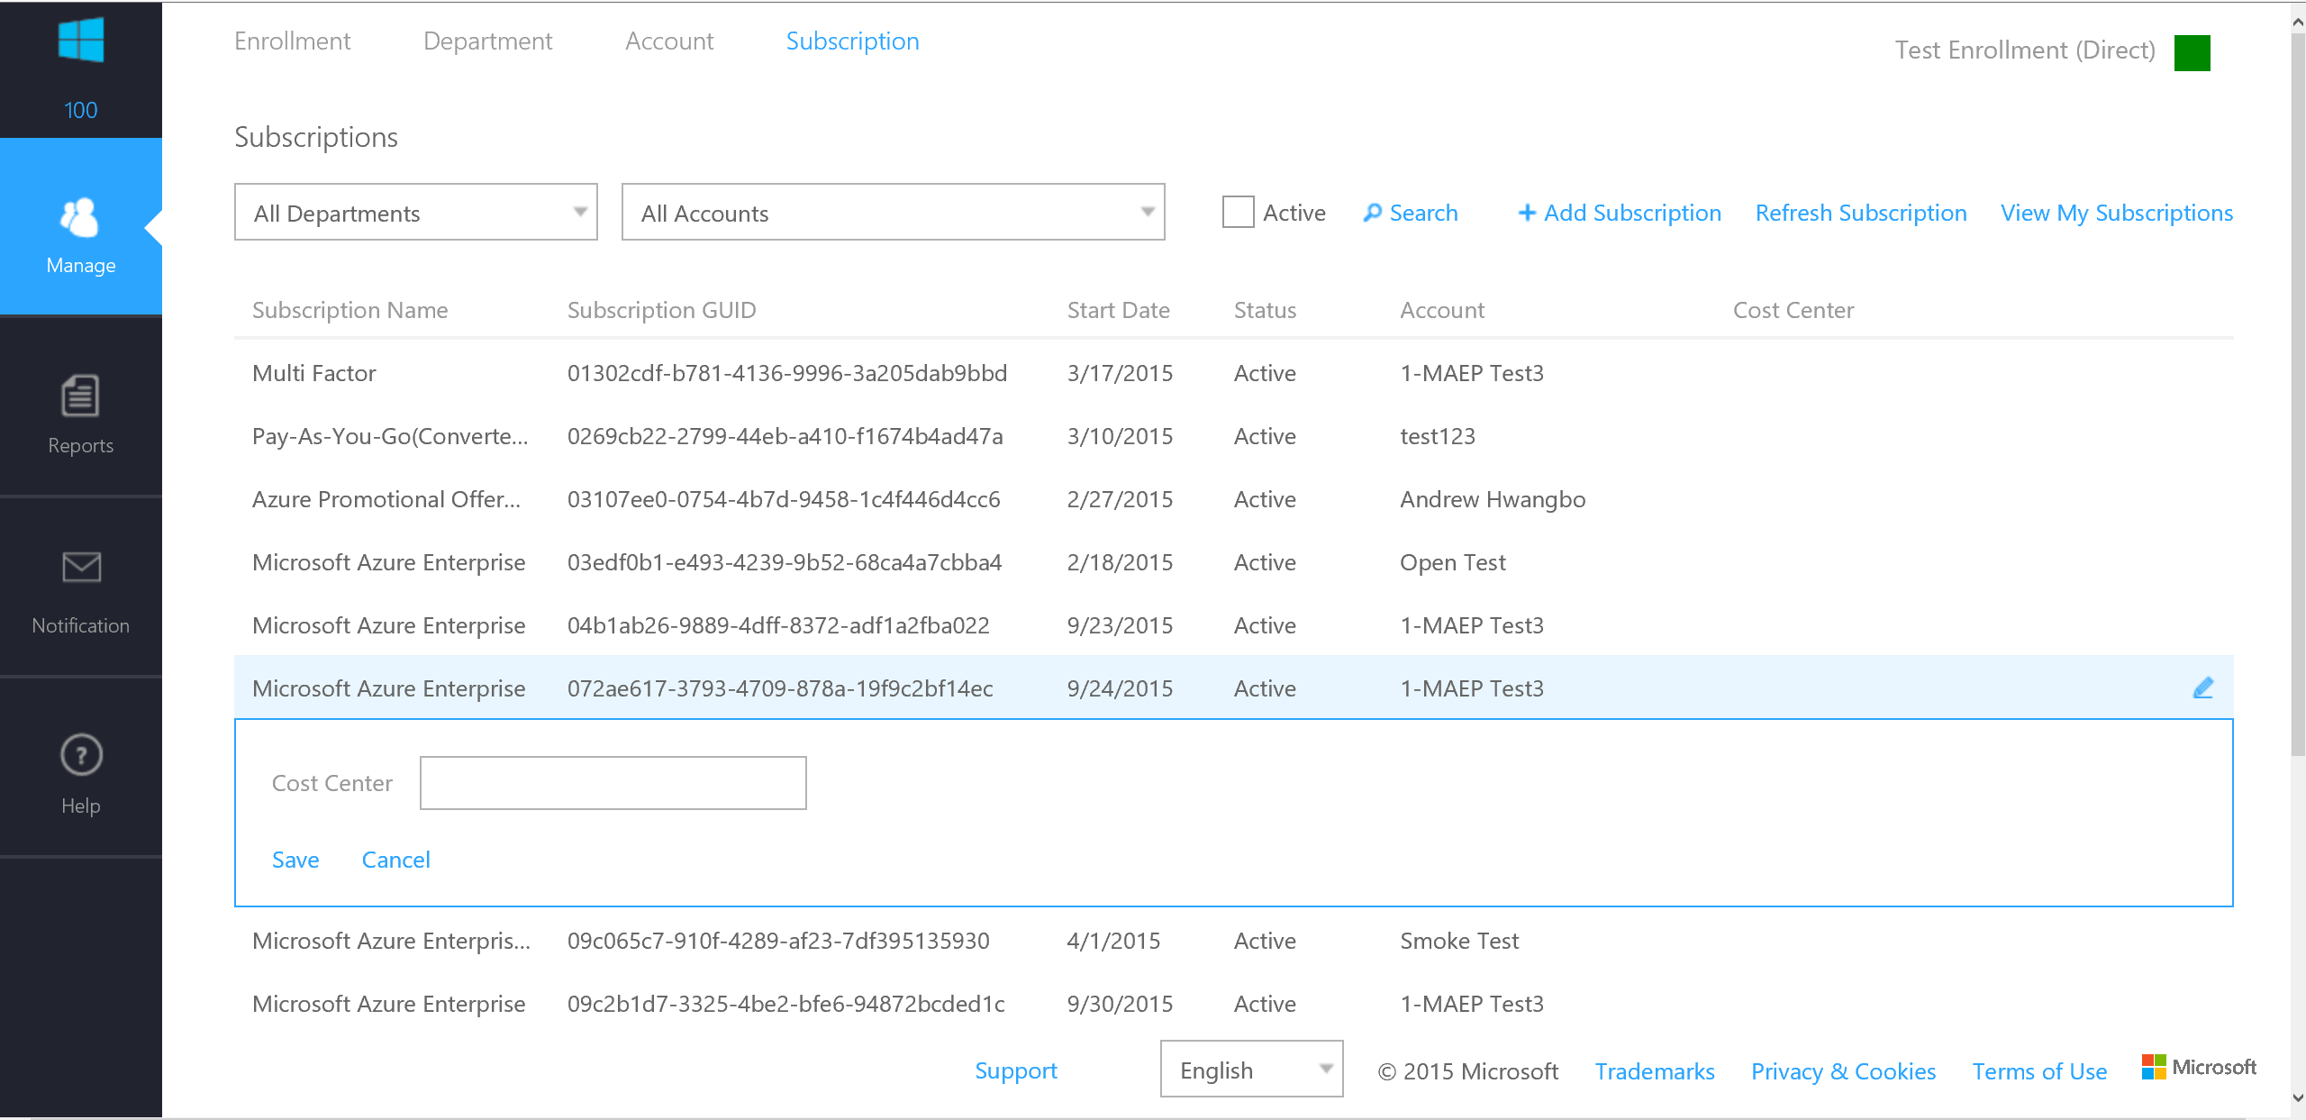
EA Portal
Notes:
Sarah
Screenshot zum EA Portal

Slide 7
Enrollment Hierarchy Options
Functional
Business Division
Geographic
Functional
Enterprise
Enterprise
Enterprise
Enterprise
Departments
Finance
Marketing
Auto
Aerospace
North America
Europe
Accounts
Proj New Plane
Prod
Non-Prod
Joe Smith
Jane Doe
Proj New Car
Subscriptions
Project 1 Dev
Project 1 Test
Production Web Sites
Application 1
Application 2
Application 3
Project 1
Project 2
Project 3
Notes:
Sarah

Slide 8
Enrollment Hierarchy Options
Enterprise enrolment roles links users with their functional role and consists of
Enterprise Administrator
Department Administrator
Account Owner
Service Administrator
Notification Contact
Notes:
Sarah

Slide 9
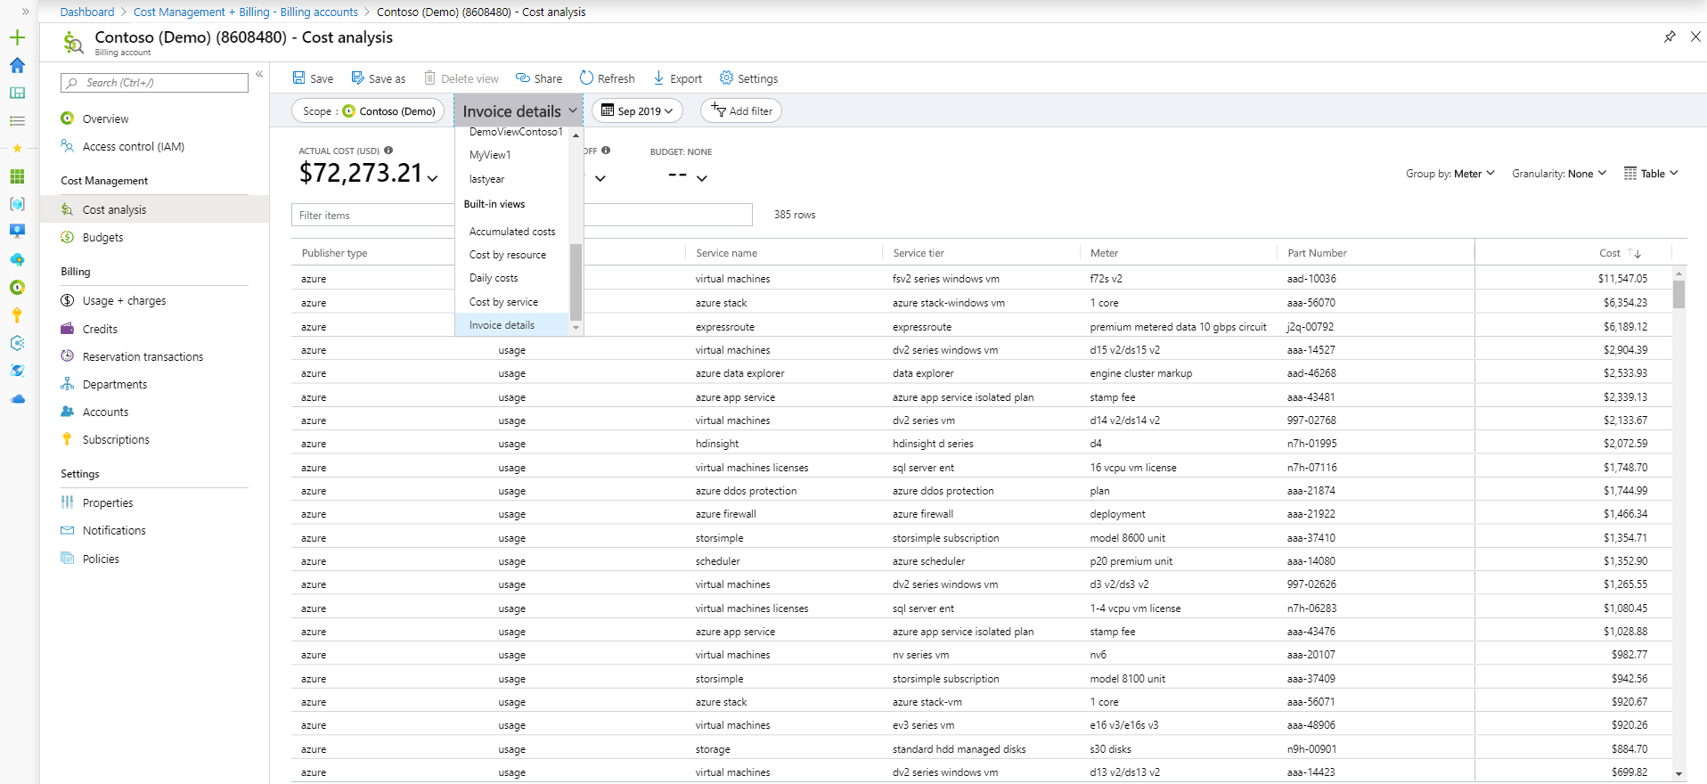

EA Portal – What about Azure Cost Management?

Slide 10
Enrollment recommendations and why?
Authentication Type: Choose AAD authentication (Work or School Account)
Authorization: Limit all roles as these are all privileged accounts!
Isolation: Decide on isolation strategy – keep devtest accounts in mind!
Notes:
Sarah
Zumindest bei Subscriptions sollten Dev Test von Prod Umgebungen getrennt werden
Empfohlen auf Account Ebene, da dort unterschiedliche Subscription Typen ausgewühlt warden können

Slide 11
Enrollment recommendations and why?
Notification: Setup notification for appropriate group mailbox.
Budgeting & Alerting: at least on account level.
Audit: Periodically audit who has access within Enterprise Portal.
Notes:
Sarah
Zumindest bei Subscriptions sollten Dev Test von Prod Umgebungen getrennt werden
Empfohlen auf Account Ebene, da dort unterschiedliche Subscription Typen ausgewühlt warden können

Slide 12
Tenants
Why do we talk about this?
Notes:
Sarah: Warum sprechen wir darüber
Niels:
Identitäts- und Zugriffsmanagement Lösung, um Azure zu schützen.
Definieren, worauf authentifizierte und autorisierte Nutzer aber auch Applikationen oder Services Zugriff haben
Stellen Sie während der Azure AD-Entwurfsphase grundlegende Sicherheitsfragen, z. B. wie Ihre Organisation Anmeldeinformationen verwaltet und wie sie den menschlichen, anwendungs- und programmgesteuerten Zugriff steuert.

Slide 13
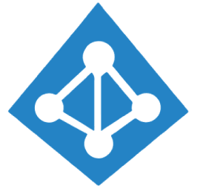
Tenants
Let’s clarify the wordings:
Azure Active Directory Tenant
Azure Active Directory
A dedicated and trusted instance of Azure AD that's automatically created when your organization signs up for a Microsoft cloud service subscription, such as Microsoft Azure, Microsoft Intune, or Microsoft 365. An Azure tenant represents a single organization.
Each Azure tenant has a dedicated and trusted Azure AD directory. The Azure AD directory includes the tenant's users, groups, and apps and is used to perform identity and access management functions for tenant resources.
Notes:
Niels
Um Azure oder andere Microsoft Cloud Services Nutzen zu können, müssen Sie die Identitätslösung AAD nutzen. Integrtionen zu einem Active Directory oder anderen Identitätsprovidern ist möglich.
Single Directory where users, groups and applications of an enterprise are managed.

Slide 14
Tenants
Azure Active Directory Tenant:
Azure Active Directory (Azure AD) organizes objects like users and apps into groups called tenants. Tenants allow an administrator to set policies on the users within the organization and the apps that the organization owns to meet their security and operational policies
Azure AD is also used by software as a service applications such as Microsoft 365 and Azure Marketplace. Organizations already using on-premises Active Directory can use their existing infrastructure and extend authentication to the cloud by integrating with Azure AD. Each Azure AD directory has one or more domains. A directory can have many subscriptions associated with it but only one Azure AD tenant.
Notes:
Design considerations:
Multiple Azure AD tenants can function in the same enrollment.

Slide 15
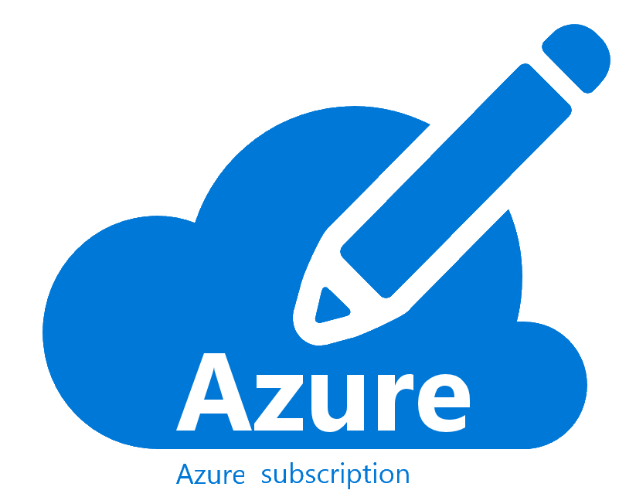


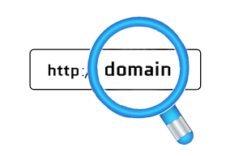

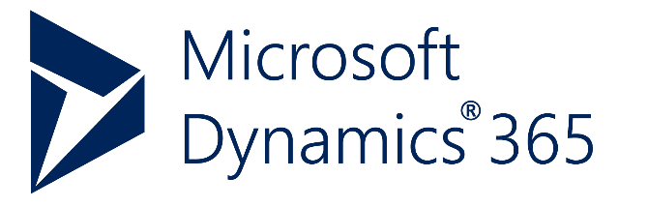
Tenants

Slide 16
Tenants
Options – to think about…
Notes:
Use Azure AD seamless single sign-on based on the selected planning topology.
If your organization doesn't have an identity infrastructure, start by implementing an Azure-AD-only identity deployment. Such deployment with Azure AD Domain Services and Microsoft Enterprise Mobility + Security provides end-to-end protection for SaaS applications, enterprise applications, and devices.
Multi-factor authentication provides another layer of security and a second barrier of authentication. Enforce multi-factor authentication and conditional access policies for all privileged accounts for greater security.
Plan and implement for emergency access or break-glass accounts to prevent tenant-wide account lockout.
Use Azure AD Privileged Identity Management for identity and access management.
If dev/test and production are going to be isolated environments from an identity perspective, separate them at a tenant level via multiple tenants.
Avoid creating a new Azure AD tenant unless there's a strong identity and access management justification and processes are already in place.

Slide 17

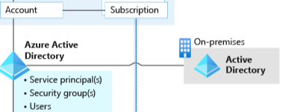


Tenants
Cloud-only strategy – only one AAD
Hybrid strategy – On-prem and AAD
Notes:
Niels
Decide on AD Integration option or start with cloud-only deployment
Cloud-only strategy – only one AAD
Hybrid strategy – On-prem AD (one or multiple forests) sync up to single AAD (many domains)
Azure Active Directory can be used for Microsoft services but also integrated to third party solutions

Slide 18
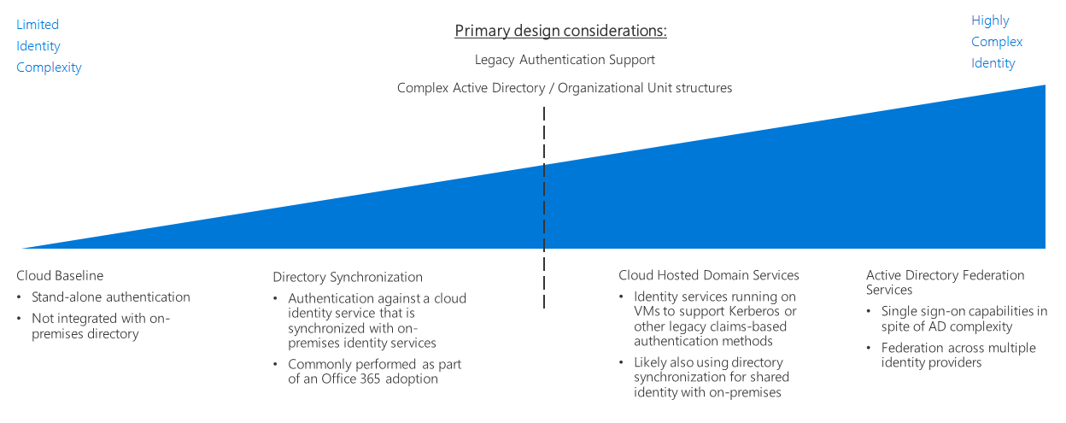
Tenants

Slide 19
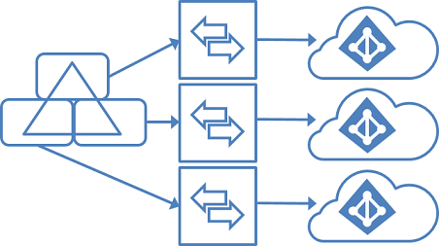
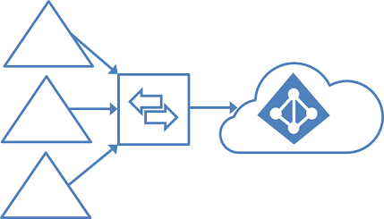
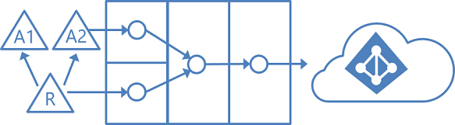
Tenants
Topologies

Slide 20






Tenants
One common identity for single sign-on
Connect users to ALL the apps they need
Microsoft Azure
Active Directory
Access on-premises apps without using a VPN
Azure AD Connect
On-premises /
Private cloud
Notes:
The first thing you need to do is to connect your on-premises Active Directory to the cloud with Azure AD Connect. Azure AD Connect is the Microsoft tool designed to meet and accomplish your hybrid identity goals. This allows you to provide a common identity for your users for Office 365, Azure, and SaaS applications integrated with Azure AD. At its core, it enables synchronization between on-premises and cloud identity infrastructures. Specifically, it creates users, groups, and other objects and ensures data is consistent between directories. Once user data is extended with the sync engine, the next consideration is a secure method to authenticate users.
App Proxy lets you use Azure AD as your authentication and authorization service for your on-premises apps as well as your cloud apps. This lets users who are remote from your business to get back to on-premises apps that are claims aware. We’ll use lightweight connectors in your firewall to do this, which lets you expose just the apps you want a user to get into out wherever they are out in the world while applying all of your common policies and security posture to them, without having to open up a VPN.
And let’s be real, VPNs are scary. Most corporate hacks start by compromising a user account, and then immediately heading to a VPN. And once I’m on your VPN, I’m in the network and I can take over pretty much whatever I want.

Slide 21
Safeguard user credentials with a Zero Trust approach
Tenants
Secure authentication
Conditional access
Identity protection
Network walls have come down but your security doesn’t have to.
Notes:
Is your end user authentication seamless and secure?
How much control do you have over access?
How do you secure identities against current and emerging threats?
So, our approach in identity and access management is really threefold:
secure authentication and we believe password-less is the best.
Conditional access to reach Zero trust
Identity protection - safeguard those identities when they are used as part of an OS session or application session.
The first question to ask yourself is, can I make my access protection stronger while also making things easier for users? This is about how people sign in, how often they have to sign in, and how we authenticate that they are who they say they are.
We find that across all of our analytics, as we look at all of those 450 billion authentications that we process every month for Azure Active Directory and Microsoft Account, that the proper application of a username and password is not a tremendous predictor of a genuinely authenticated person. In other words, just knowing the username and password doesn't prove that I am who I say I am. How can we improve that? How can we get to a world that's beyond passwords, beyond what we know are faulted technology for proving authentication, and at the same time make it easier for end users?
The second question is, how much control do you really have over access? Not only who is accessing what but also, can those access control policies change depending on the conditions?
So, for example, I might be a very trustworthy employee of Microsoft today, and I might be allowed to access certain sensitive information. Tomorrow, I might be a slightly less trustworthy employee, for a variety of reasons we'll get into in a moment, and I might not be allowed to access that same information. Can your access control policies adapt to those changing conditions? Can you make decisions on the fly? This is a technique being championed by many industry experts and analysts.
Some analysts refer to this as adaptive security. The identity space is the primary control point for such a capability.
And then lastly, we ask, how do you protect user credentials? This is really about, in this imperfect world where we do sometimes rely on username and password, keeping those credentials protected once they're used. So that when they're stored as part of an operating system session for example, that they can't be hijacked by an attacker and then used to access other things that the genuine legitimate user is not trying to access.
EMS Overview
© 2014 Microsoft Corporation. All rights reserved. Microsoft, Windows, Surface and other product names are or may be registered trademarks and/or trademarks in the U.S. and/or other countries. The information herein is for informational purposes only and represents the current view of Microsoft Corporation as of the date of this presentation. Because Microsoft must respond to changing market conditions, it should not be interpreted to be a commitment on the part of Microsoft, and Microsoft cannot guarantee the accuracy of any information provided after the date of this presentation. MICROSOFT MAKES NO WARRANTIES, EXPRESS, IMPLIED OR STATUTORY, AS TO THE INFORMATION IN THIS PRESENTATION.
9/27/2021
21

Slide 22
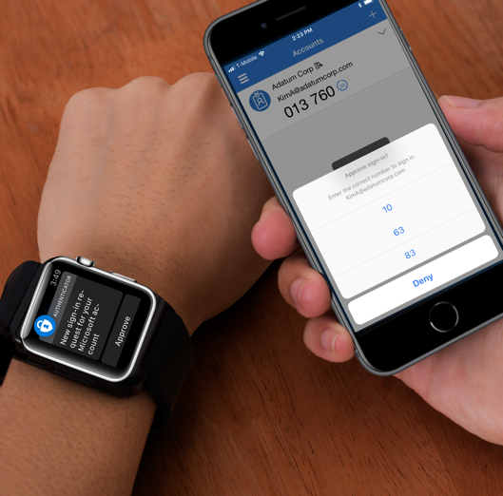



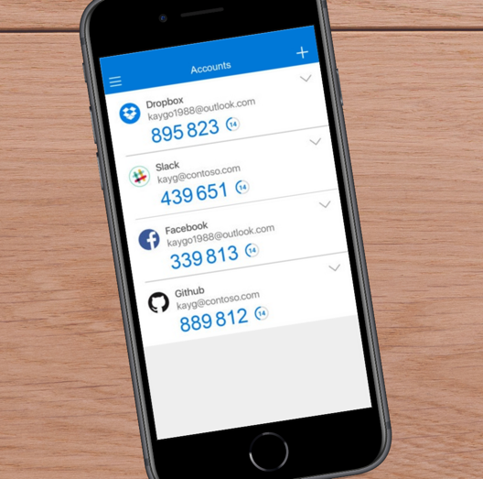
Secure authentication using MFA
Tenants
Push notification
SMS
Voice call
OATH Token
OATH codes
Multi-factor authentication prevents 99.9% of identity attacks
Notes:
Passwords are your biggest vulnerability, partly because they are the target of most attacks we see today. 81% of all attacks were the result of weak/compromised credentials. But there is hope. We are investing in the next gen of authentication solutions such as password-less authentication where you can eliminate passwords entirely from the end user flow. We also continue to invest in tried and tested solutions such as MFA as well as innovative cloud-powered solutions like Azure AD Password Protection to help you secure your user credentials.
Multi-factor Authentication (MFA) can protect you against 99.9% of identity attacks including Phishing, breach replay and password spray – the most predominant identity attacks today. We heard feedback from our customers to include more options and we recently announced the support for OATH hardware tokens for MFA. There is no longer an excuse for organizations to not turn on MFA! But there is more..

Slide 23








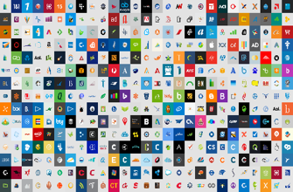


Azure AD conditional access
Azure AD
ADFS
Conditions
Controls
MSA
40TB
Google ID
Employee & Partner Users and Roles
Allow/block
access
Microsoft Cloud
Android
Session Risk
iOS
Trusted & Compliant Devices
Machine learning
3
MacOS
Limited
access
Microsoft Cloud App Security
Windows
Windows Defender ATP
Require
MFA
Real time Evaluation
Engine
Cloud SaaS apps
Force
password
reset
Geo-location
Physical & Virtual Location
******
Corporate Network
Policies
Effective policy
Client apps & Auth Method
Block legacy authentication
Browser apps
Client apps
On-premises & web apps
Notes:
Expanded view of all the conditions that are taken into account for access and the controls that you have based on the risk.
Our 40 TB of data from all the conditions, integrated EMS/M365 apps, and our security intelligence network are analyzed in real-time to determine the right policy.
Example: If an ADFS user signs in on a Windows machine with Windows Defender ATP we can take into account the health of the account and the device, as well as their location and if they are on the corporate network and what type of app they are trying to access. If they are on the corporate network in their normal office then the data produces a low risk score. The effective policy is to all access to the app. If, however, the person was logging in from a location across the world (in a short amount of time – impossible travel) and/or the Windows Defender ATP finds that the machine has been infected, the access can be blocked. If the user login and device are healthy, but it was a location they haven’t signed in from before (on a trip or other computer) then the user could be prompted with MFA or have limited access to certain applications.

Slide 24

Azure AD Identity Protection
Tenants
Continuous detection
Connected intelligence
Apply artificial intelligence and human expertise to derive accurate insights
Actionable insights
Observe trillions of signals and risk events from cloud systems
Send alerts, self-mitigate, and automatically remediate threats

Slide 25
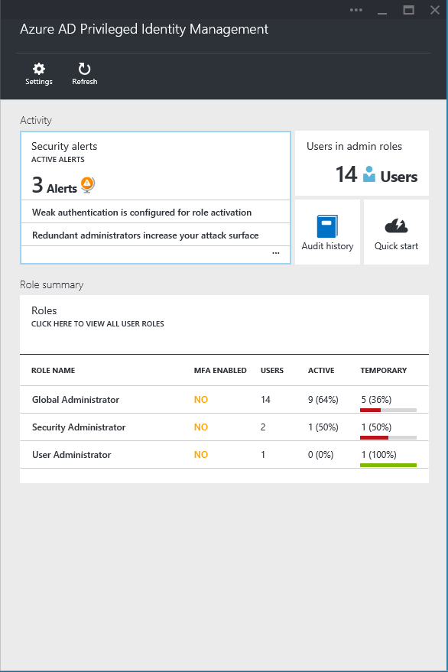
Tenants
Azure AD Privileged Identity Management
Discover, restrict, and monitor privileged identities
User
Administrator
Administrator privileges expire after a specified interval
User
Enforce on-demand, just-in-time administrative access when needed
Ensure policies are met with alerts, audit reports and access reviews
Manage admins access in Azure AD and also in Azure RBAC

Slide 26
Tenant recommendations and why?
Usability: Use seamless Single Sign on
Cloud-only or hybrid: start where you are at – when you have no identity infrastructure make use of AAD only identity deployment with f.e. AAD DS in place.
Security: Enforce MFA and use conditional access policies!
Emergency access: Use breaking glass accounts to prevent tenant wide account lockout
Privileged Access: Secure privileged users or devices with AAD Privileged Identity Management
Isolation: Decide wisely if isolated environments from an identity perspective is needed, if yes, use multiple tenants.
BUT: Avoid creating a new AAD tenant unless there is a strong justification in place!
Notes:
Sarah
During an emergency, you do not want a policy to potentially block your access to fix an issue. At least one emergency access account should be excluded from all Conditional Access policies.

Slide 27
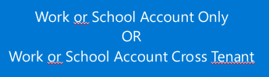
Dependencies
Multi-tenancy: Multiple AAD tenants can exist in one enrollment
Security barrier: Account admin decides in what AAD subscription lands. Select single or multi tenant strategy within enterprise enrollment wisely!
Notes:
Sarah

Slide 28
Keep in mind!
Secure & Monitor: Within Enrollment and AAD privileged roles are set and managed
Start small: Minimize the number of privileged accounts
Dependencies: Enrollment and tenants have significant dependencies
Contract: EA is mostly used now – but keep an eye on MCA developments to integrate better with CSP
Isolation: Decide on isolation strategy and enforce it with simple settings
Notes:
Sarah:
Kurze Zusammenfassung

Slide 29
Photo layout 1
Identity and Access Managment

Slide 30
Introduction Azure Active Directory

Slide 31

Identity & Access Management (IAM)
Let’s clarify the wordings:
Azure Active Directory Tenant
Azure Active Directory
A dedicated and trusted instance of Azure AD that's automatically created when your organization signs up for a Microsoft cloud service subscription, such as Microsoft Azure, Microsoft Intune, or Microsoft 365. An Azure tenant represents a single organization.
Each Azure tenant has a dedicated and trusted Azure AD directory. The Azure AD directory includes the tenant's users, groups, and apps and is used to perform identity and access management functions for tenant resources.
Notes:
Niels
Um Azure oder andere Microsoft Cloud Services Nutzen zu können, müssen Sie die Identitätslösung AAD nutzen. Integrtionen zu einem Active Directory oder anderen Identitätsprovidern ist möglich.
Single Directory where users, groups and applications of an enterprise are managed.

Slide 32
IAM
One common identity for single sign-on
Connect users to ALL the apps they need
Microsoft Azure
Active Directory
Access on-premises apps without using a VPN
Azure AD Connect
On-premises /
Private cloud
Notes:
The first thing you need to do is to connect your on-premises Active Directory to the cloud with Azure AD Connect. Azure AD Connect is the Microsoft tool designed to meet and accomplish your hybrid identity goals. This allows you to provide a common identity for your users for Office 365, Azure, and SaaS applications integrated with Azure AD. At its core, it enables synchronization between on-premises and cloud identity infrastructures. Specifically, it creates users, groups, and other objects and ensures data is consistent between directories. Once user data is extended with the sync engine, the next consideration is a secure method to authenticate users.
App Proxy lets you use Azure AD as your authentication and authorization service for your on-premises apps as well as your cloud apps. This lets users who are remote from your business to get back to on-premises apps that are claims aware. We’ll use lightweight connectors in your firewall to do this, which lets you expose just the apps you want a user to get into out wherever they are out in the world while applying all of your common policies and security posture to them, without having to open up a VPN.
And let’s be real, VPNs are scary. Most corporate hacks start by compromising a user account, and then immediately heading to a VPN. And once I’m on your VPN, I’m in the network and I can take over pretty much whatever I want.

Slide 33
IAM
Azure Active Directory
Editions
Free
Base Azure Active Directory tenant
Office 365 Apps
Part of an Office 365 based subscription
Premium P1
Available direct, or through EMS E3 and M365 E3 licenses
Premium P2
Available direct, or through EMS E5 and M365 E5 licenses

Slide 34
Azure Active Directory Edition Features
Free
500,000 Directory Objects
User And Group Management
Unlimited SSO Applications
Device Registration
Federated Authentication
Cloud Authentication
Azure AD Connect
Azure AD Join
Cloud User Password Protection
Basic Security Reports
Azure AD Features for Guest Users
Azure AD Security Defaults MFA

Slide 35
Azure Active Directory Edition Features
Office 365 Apps
Unlimited Directory Objects
User And Group Management
Unlimited SSO Applications
Device Registration
Federated Authentication
Cloud Authentication
Azure AD Connect
Azure AD Join
Cloud User Password Protection
Basic Security Reports
Azure AD Features for Guest Users
Per-user Multi-Factor Authentication
Company Branding
Device write-back

Slide 36
Azure Active Directory Edition Features
Premium P1
Unlimited Directory Objects
User And Group Management
Unlimited SSO Applications
Device Registration
Federated Authentication
Cloud Authentication
Azure AD Connect
Azure AD Join Premium Features
Cloud User Password Protection
Advanced Security Reports
Azure AD Features for Guest Users
CA Multi-Factor Authentication
Company Branding
Device write-back
Advanced Group Access Management
Custom Banned Passwords
Active Directory Password Protection
User SSPR with password write-back
Azure AD Connect Health
Azure AD Application Proxy
Conditional Access Policies
Administrative Units (Preview)
Microsoft Identity Manager User CAL

Slide 37
Azure Active Directory Edition Features
Premium P2
Unlimited Directory Objects
User And Group Management
Unlimited SSO Applications
Device Registration
Federated Authentication
Cloud Authentication
Azure AD Connect
Azure AD Join Premium Features
Cloud User Password Protection
Advanced Security Reports
Azure AD Features for Guest Users
CA Multi-Factor Authentication
Company Branding
Device write-back
Advanced Group Access Management
Custom Banned Passwords
Active Directory Password Protection
User SSPR with password write-back
Azure AD Connect Health
Azure AD Application Proxy
Conditional Access Policies
Administrative Units (Preview)
Microsoft Identity Manager User CAL
Azure AD Identity Protection
Privileged Identity Management
Identity Governance

Slide 38
Fundamentals

Slide 39
IAM – Why?
The technological landscape in the enterprise is becoming complex and heterogenous. To manage compliance and security for this environment, IAM enables the right individuals to access the right resources at the right time for the right reasons.

Slide 40
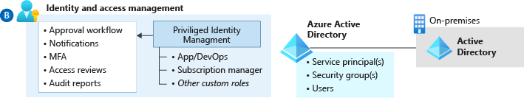
IAM – Why?
Enterprise organizations typically follow a least-privileged approach to operational access. This model should be expanded to consider Azure through Azure Active Directory (Azure AD), Azure role-based access control (Azure RBAC), and custom role definitions.
Notes:
It's critical to plan how to govern control- and data-plane access to resources in Azure. Any design for IAM and Azure RBAC must meet regulatory, security, and operational requirements before it can be accepted.

Slide 41
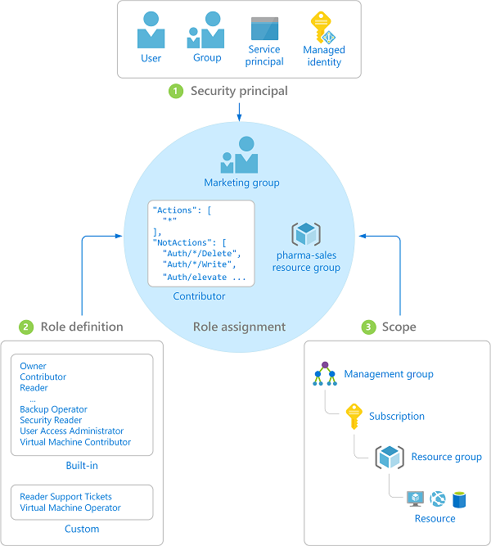
IAM – RBAC
Fine-grained access control to Azure “control plane”
Grant access by assigning Security Principal a Role at a Scope
Security Principal: User, group, or service principal
Role: Built-in or custom role
Scope: Subscription, resource group, or resource
Assignments are inherited down the resource hierarchy
Learn more https://aka.ms/azureiam
Notes:
It's critical to plan how to govern control- and data-plane access to resources in Azure. Any design for IAM and Azure RBAC must meet regulatory, security, and operational requirements before it can be accepted.

Slide 42
Plan for identity and access management

Slide 43
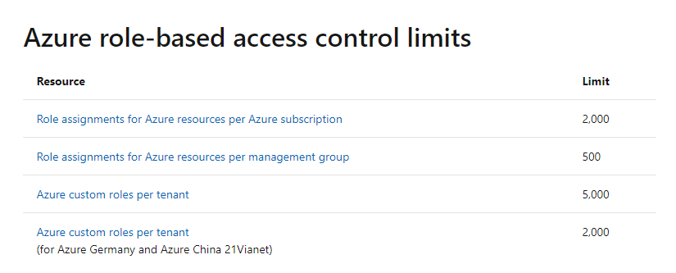
IAM – Design Considerations
There are limits around the number of custom roles and role assignments that must be considered when you lay down a framework around IAM and governance.

Slide 44
IAM – Design Considerations
Centralized versus federated resource ownership
Shared resources or any aspect of the environment that implements or enforces a security boundary, such as the network, must be managed centrally. This requirement is part of many regulatory frameworks. It's standard practice for any organization that grants or denies access to confidential or critical business resources.
Managing application resources that don't violate security boundaries or other aspects required to maintain security and compliance can be delegated to application teams. Allowing users to provision resources within a securely managed environment allows organizations to take advantage of the agile nature of the cloud while preventing the violation of any critical security or governance boundary.

Slide 45
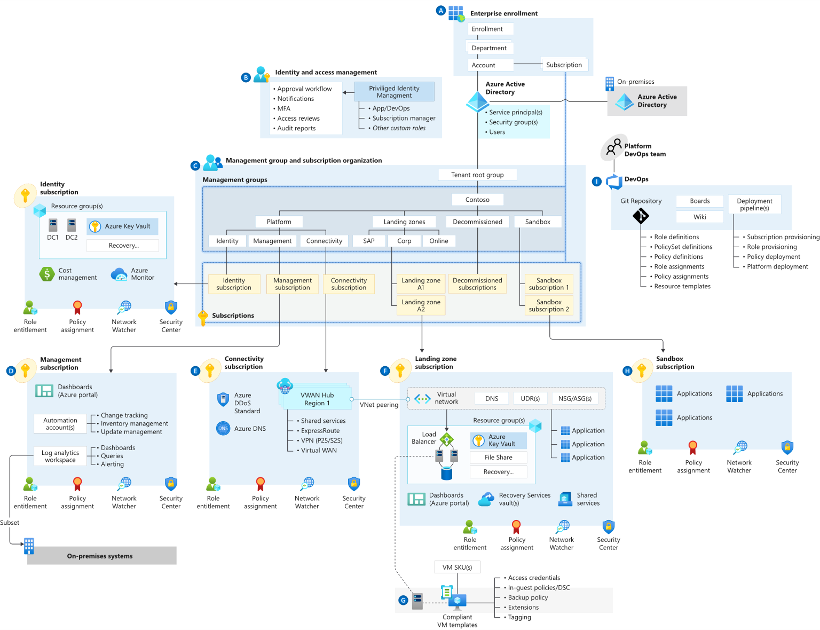
IAM – Design Considerations

Slide 46
IAM – Design Recommendations I
Use Azure RBAC to manage data-plane access to resources, where possible. Examples are Azure Key Vault, a storage account, or a SQL database.
Deploy Azure AD conditional-access policies for any user with rights to Azure environments. Doing so provides another mechanism to help protect a controlled Azure environment from unauthorized access.
Enforce multi-factor authentication for any user with rights to the Azure environments. Multi-factor authentication enforcement is a requirement of many compliance frameworks. It greatly lowers the risk of credential theft and unauthorized access.

Slide 47
Azure AD conditional access
Azure AD
ADFS
Conditions
Controls
MSA
40TB
Google ID
Employee & Partner Users and Roles
Allow/block
access
Microsoft Cloud
Android
Session Risk
iOS
Trusted & Compliant Devices
Machine learning
3
MacOS
Limited
access
Microsoft Cloud App Security
Windows
Windows Defender ATP
Require
MFA
Real time Evaluation
Engine
Cloud SaaS apps
Force
password
reset
Geo-location
Physical & Virtual Location
******
Corporate Network
Policies
Effective policy
Client apps & Auth Method
Block legacy authentication
Browser apps
Client apps
On-premises & web apps
Notes:
Expanded view of all the conditions that are taken into account for access and the controls that you have based on the risk.
Our 40 TB of data from all the conditions, integrated EMS/M365 apps, and our security intelligence network are analyzed in real-time to determine the right policy.
Example: If an ADFS user signs in on a Windows machine with Windows Defender ATP we can take into account the health of the account and the device, as well as their location and if they are on the corporate network and what type of app they are trying to access. If they are on the corporate network in their normal office then the data produces a low risk score. The effective policy is to all access to the app. If, however, the person was logging in from a location across the world (in a short amount of time – impossible travel) and/or the Windows Defender ATP finds that the machine has been infected, the access can be blocked. If the user login and device are healthy, but it was a location they haven’t signed in from before (on a trip or other computer) then the user could be prompted with MFA or have limited access to certain applications.

Slide 48
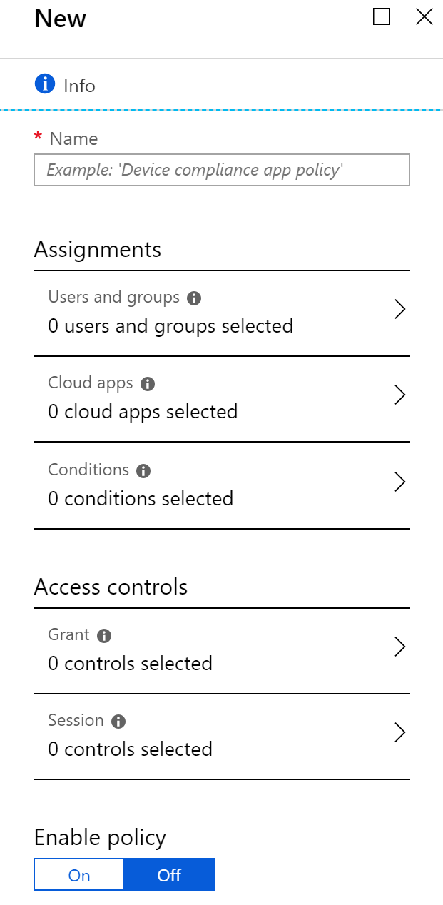
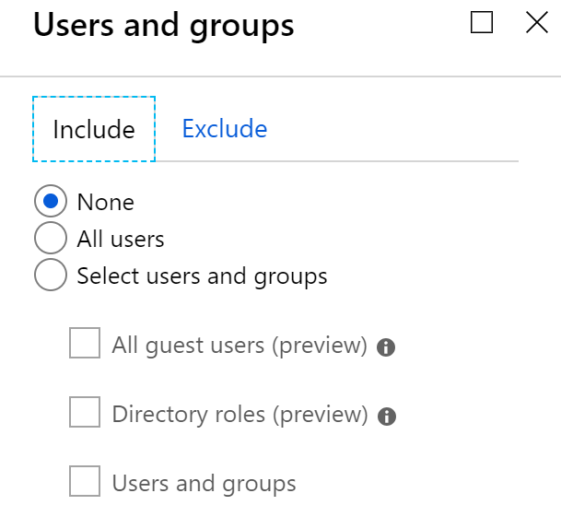
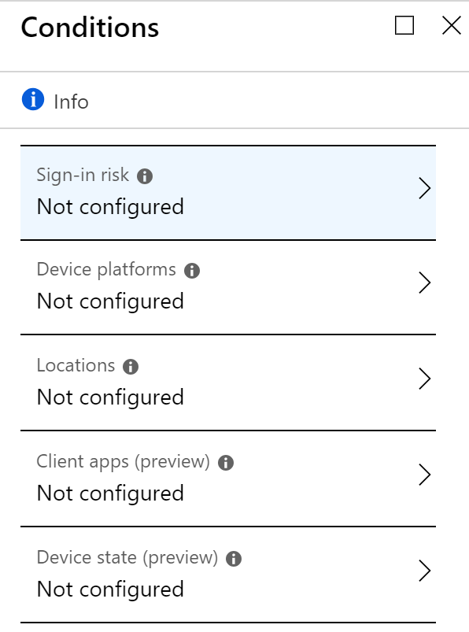
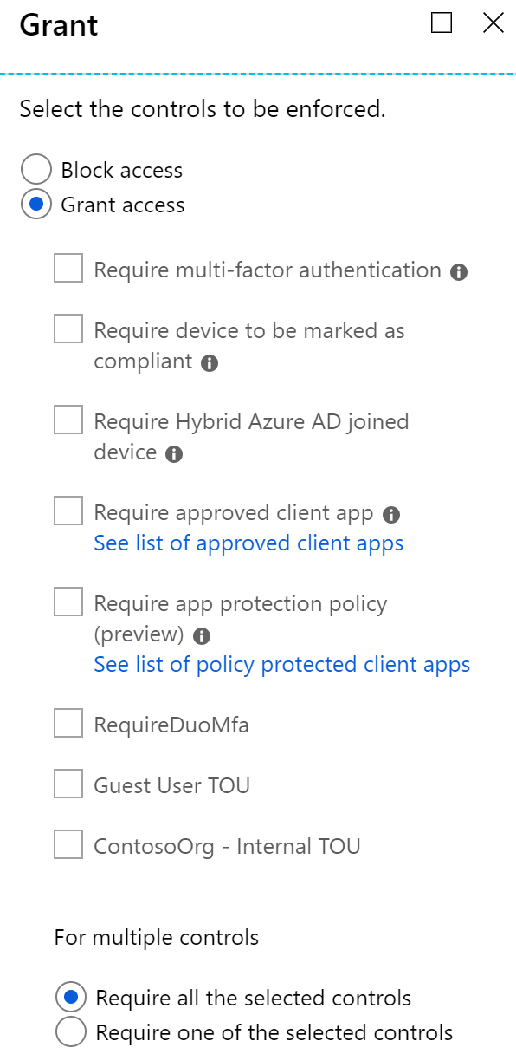
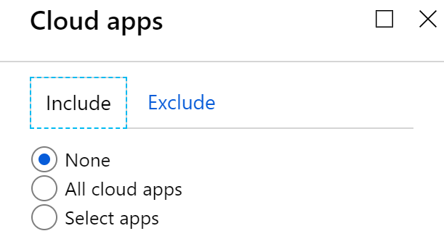
IAM – Access Management – Conditional Access

Slide 49
IAM - MFA
App Passwords
Trusted IPs
Verification Options
Remember MFA
For non-browser apps that do not support Modern Authentication**
External IPs that will bypass MFA
Global setting for administrators to select what verifications methods are available for the users
This provides users the ability to remember the current device for X amount of days*
*Discouraged Setting for security purposes
**App passwords are highly discouraged; they may be retired soon.
Notes:
Passwords are your biggest vulnerability, partly because they are the target of most attacks we see today. 81% of all attacks were the result of weak/compromised credentials. But there is hope. We are investing in the next gen of authentication solutions such as password-less authentication where you can eliminate passwords entirely from the end user flow. We also continue to invest in tried and tested solutions such as MFA as well as innovative cloud-powered solutions like Azure AD Password Protection to help you secure your user credentials.
Multi-factor Authentication (MFA) can protect you against 99.9% of identity attacks including Phishing, breach replay and password spray – the most predominant identity attacks today. We heard feedback from our customers to include more options and we recently announced the support for OATH hardware tokens for MFA. There is no longer an excuse for organizations to not turn on MFA! But there is more..

Slide 50
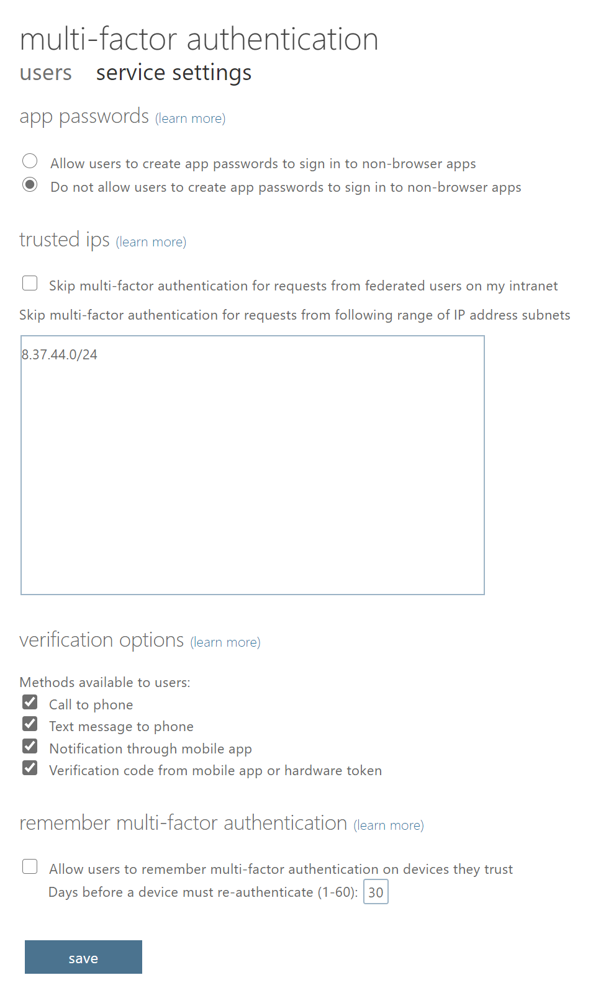
IAM - MFA
Notes:
Passwords are your biggest vulnerability, partly because they are the target of most attacks we see today. 81% of all attacks were the result of weak/compromised credentials. But there is hope. We are investing in the next gen of authentication solutions such as password-less authentication where you can eliminate passwords entirely from the end user flow. We also continue to invest in tried and tested solutions such as MFA as well as innovative cloud-powered solutions like Azure AD Password Protection to help you secure your user credentials.
Multi-factor Authentication (MFA) can protect you against 99.9% of identity attacks including Phishing, breach replay and password spray – the most predominant identity attacks today. We heard feedback from our customers to include more options and we recently announced the support for OATH hardware tokens for MFA. There is no longer an excuse for organizations to not turn on MFA! But there is more..

Slide 51
IAM – Design Recommendations II
Use Azure AD Privileged Identity Management (PIM) to establish zero standing access and least privilege. Map your organization's roles to the minimum level of access needed. Azure AD PIM can either be an extension of existing tools and processes, use Azure native tools as outlined, or use both as needed.
Use Azure-AD-only groups for Azure control-plane resources in Azure AD PIM when you grant access to resources.
Add on-premises groups to the Azure-AD-only group if a group management system is already in place.
Use Azure AD PIM access reviews to periodically validate resource entitlements. Access reviews are part of many compliance frameworks. As a result, many organizations will already have a process in place to address this requirement.

Slide 52
IAM – PIM
Azure AD Privileged Identity Management
Discover, restrict, and monitor privileged identities
User
Administrator
Administrator privileges expire after a specified interval
User
Enforce on-demand, just-in-time administrative access when needed
Ensure policies are met with alerts, audit reports and access reviews
Manage admins access in Azure AD and also in Azure RBAC

Slide 53
IAM – Design Recommendations III
Integrate Azure AD logs with the platform-central Azure Monitor. Azure Monitor allows for a single source of truth around log and monitoring data in Azure, which gives organizations cloud-native options to meet requirements around log collection and retention.
If any data sovereignty requirements exist, custom user policies can be deployed to enforce them.
Use custom role definitions within the Azure AD tenant while you consider the following key roles…

Slide 54
IAM – custom role definitions – key roles:
Role | Usage | Actions | No actions
Azure platform owner (such as the built-in Owner role) | Management group and subscription lifecycle management | *
Network management (NetOps) | Platform-wide global connectivity management: Virtual networks, UDRs, NSGs, NVAs, VPN, Azure ExpressRoute, and others | */read, Microsoft.Network/vpnGateways/*, Microsoft.Network/expressRouteCircuits/*, Microsoft.Network/routeTables/write, Microsoft.Network/vpnSites/*
Security operations (SecOps) | Security administrator role with a horizontal view across the entire Azure estate and the Azure Key Vault purge policy | */read, */register/action, Microsoft.KeyVault/locations/deletedVaults/purge/action, Microsoft.Insights/alertRules/*, Microsoft.Authorization/policyDefinitions/*, Microsoft.Authorization/policyAssignments/*, Microsoft.Authorization/policySetDefinitions/*, Microsoft.PolicyInsights/*, Microsoft.Security/*
Subscription owner | Delegated role for subscription owner derived from subscription Owner role | * | Microsoft.Authorization/*/write, Microsoft.Network/vpnGateways/*, Microsoft.Network/expressRouteCircuits/*, Microsoft.Network/routeTables/write, Microsoft.Network/vpnSites/*
Application owners (DevOps/AppOps) | Contributor role granted for application/operations team at resource group level | * | Microsoft.Authorization/*/write, Microsoft.Network/publicIPAddresses/write, Microsoft.Network/virtualNetworks/write, Microsoft.KeyVault/locations/deletedVaults/purge/action

Slide 55
IAM – Design Recommendations IV
Use Azure Security Center just-in-time access for all infrastructure as a service (IaaS) resources to enable network-level protection for ephemeral user access to IaaS virtual machines.
Use Azure-AD-managed identities for Azure resources to avoid authentication based on user names and passwords. Because many security breaches of public cloud resources originate with credential theft embedded in code or other text sources, enforcing managed identities for programmatic access greatly reduces the risk of credential theft.
Use privileged identities for automation runbooks that require elevated access permissions. Automated workflows that violate critical security boundaries should be governed by the same tools and policies users of equivalent privilege are.
Don't add users directly to Azure resource scopes. Instead add users to defined roles, which are then assigned to resource scopes. Direct user assignments circumvent centralized management, greatly increasing the management required to prevent unauthorized access to restricted data

Slide 56
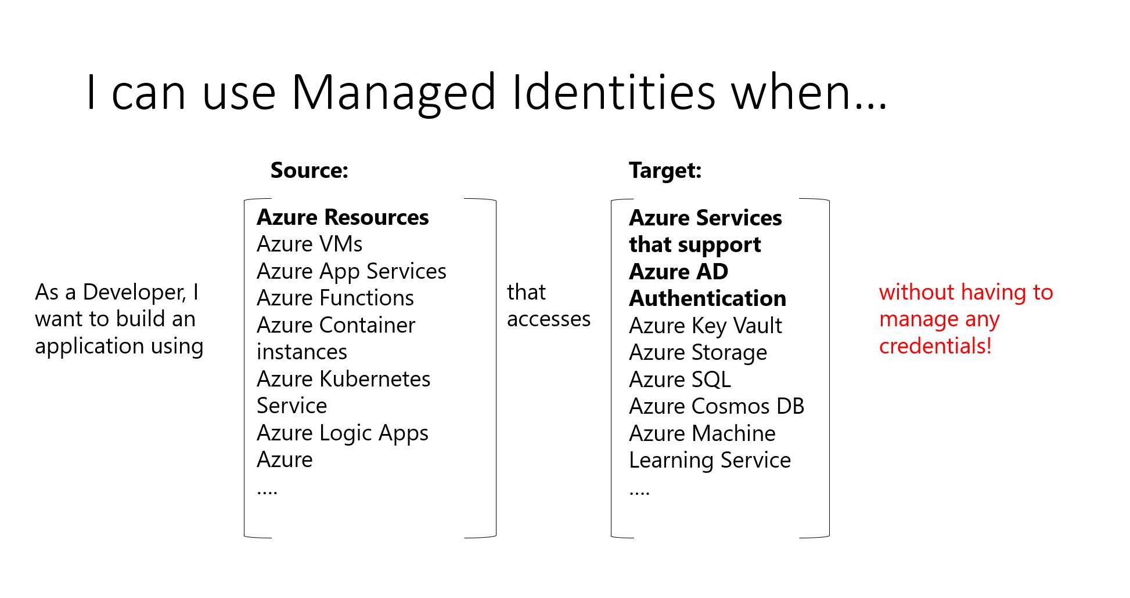
IAM – Azure-AD-managed identities

Slide 57
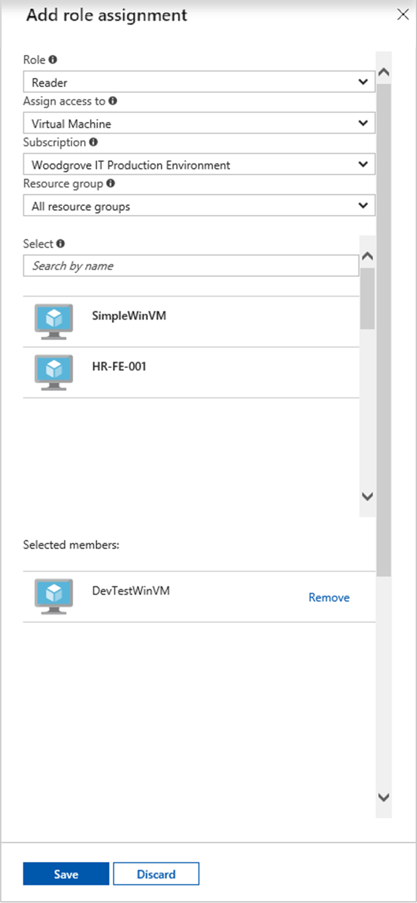
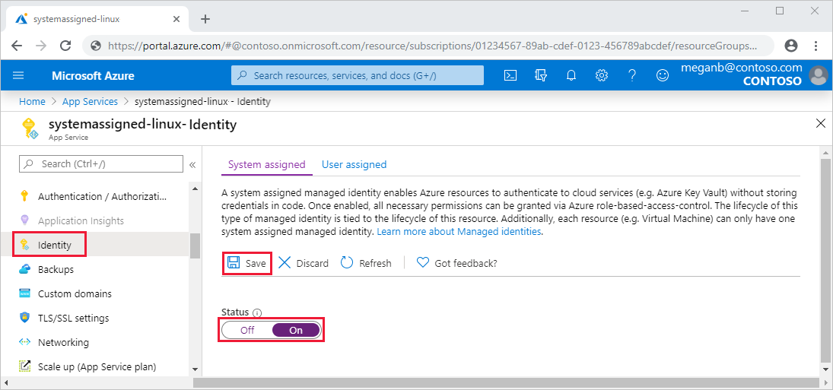
IAM – Azure-AD-managed identities

Slide 58
Plan for authentication inside a landing zone

Slide 59
IAM – Design Considerations
A critical design decision that an enterprise organization must make when adopting Azure is whether to extend an existing on-premises identity domain into Azure or to create a brand new one.
Requirements for authentication inside the landing zone should be thoroughly assessed and incorporated into plans to deploy Active Directory Domain Services (AD DS) in Windows Server, Azure AD Domain Services (Azure AD DS), or both. Most Azure environments will use at least Azure AD for Azure fabric authentication and AD DS local host authentication and group policy management.
Consider centralized and delegated responsibilities to manage resources deployed inside the landing zone.
Applications that rely on domain services and use older protocols can use Azure AD DS.

Slide 60
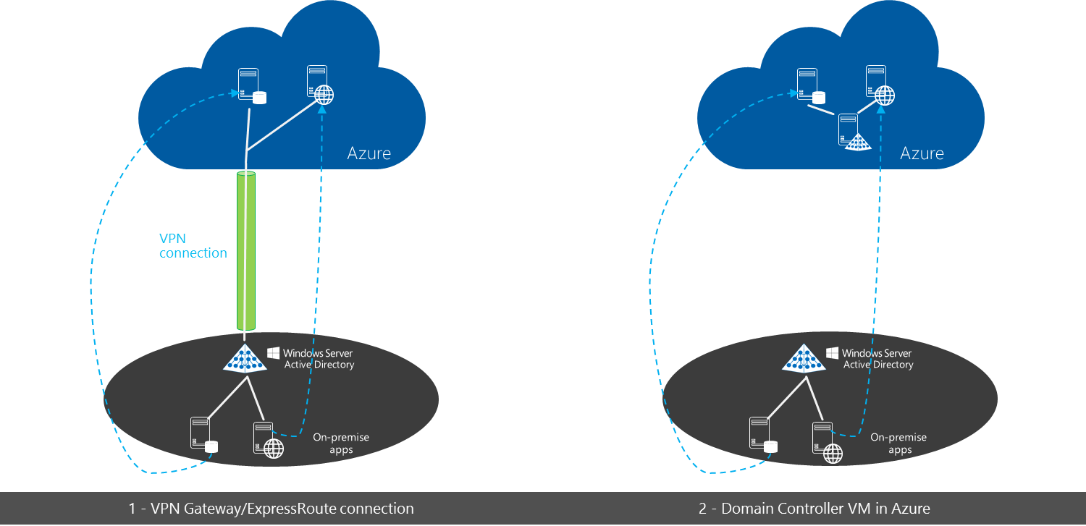
IAM – Active Directory Domain Services

Slide 61
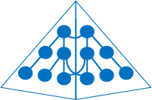
IAM – Azure Active Directory Domain Services
Managed domain available in Contoso’s VNet.
Virtual network
Azure AD Domain Services
Azure
Active Directory
…
Contoso’s workloads/apps in Azure IaaS

Slide 62

IAM – Azure Active Directory Domain Services, Sync with on-prem
Automatic background sync to your managed domain
Managed domain available in Contoso’s VNet.
Azure AD Connect
Virtual network
Azure AD Domain Services
Azure
Active Directory
…
Active Directory
Contoso’s workloads/apps in Azure IaaS

Slide 63
IAM – Design Recommendations I
Use centralized and delegated responsibilities to manage resources deployed inside the landing zone based on role and security requirements.
Privileged operations such as creating service principal objects, registering applications in Azure AD, and procuring and handling certificates or wildcard certificates require special permissions. Consider which users will be handling such requests and how to secure and monitor their accounts with the degree of diligence required.
If an organization has a scenario where an application that uses integrated Windows authentication must be accessed remotely through Azure AD, consider using Azure AD Application Proxy.

Slide 64
IAM – Azure AD Application Proxy
Remote Access as a Service
Easily publish your on-premises applications to users outside the corporate network
Extend Azure AD to on-prem
Utilize Azure AD as a central management point for all your apps
On-Premises Applications
Azure Active Directory

Slide 65
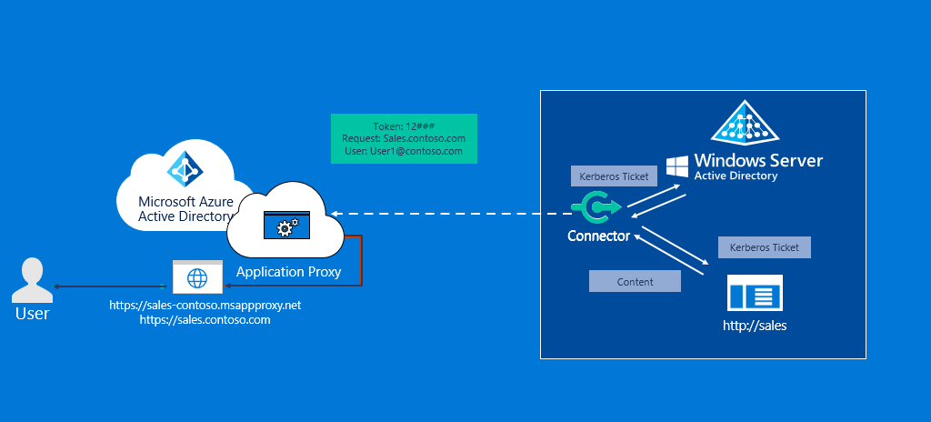
IAM – Azure AD Application Proxy

Slide 66
IAM – Design Recommendations II
There's a difference between Azure AD, Azure AD DS, and AD DS running on Windows Server. Evaluate your application needs, and understand and document the authentication provider that each one will be using. Plan accordingly for all applications.
Evaluate the compatibility of workloads for AD DS on Windows Server and for Azure AD DS.
Ensure your network design allows resources that require AD DS on Windows Server for local authentication and management to access the appropriate domain controllers.
For AD DS on Windows Server, consider shared services environments that offer local authentication and host management in a larger enterprise-wide network context.

Slide 67
IAM – Design Recommendations III
Deploy Azure AD DS within the primary region because this service can only be projected into one subscription.
Use managed identities instead of service principals for authentication to Azure services. This approach reduces exposure to credential theft.

Slide 68
Photo layout 1
Management Group & Subscription Organization
Notes:
Niels

Slide 69
Management Group Hierarchy
Why do we talk about this?
Notes:
Niels: Warum sprechen wir darüber?
Sarah:
Um Azure im Unternehmenskontext skalierbar zu gestalten, sollte man sich genau überlegen, wie Management Groups das unterstützen können

Slide 70
Management Group Hierarchy
Management Group:
Container of multiple subscriptions to efficiently manage access, policies, and compliance for those subscriptions at scale.
Dependent on single AAD Tenant:
Subscriptions are connected to an AAD Tenant, therefore Management Group Hierarchies are always dependent on one single AAD Tenant and all subscriptions underneath are placed under the root management group by default.
Limited to six levels of depth – keep management group hierarchy flat!
Notes:
Sarah:
Was ist das?
Management groups can be used to aggregate policy and initiative assignments via Azure Policy.
A management group tree can support up to six levels of depth. This limit doesn't include the tenant root level or the subscription level.
Any principal (user, service principal) within an Azure AD tenant can create new management groups as Azure role-based access control (Azure RBAC) authorization for management group operations is not enabled by default.
All new subscription will be placed under the root management group by default.

Slide 71
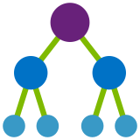
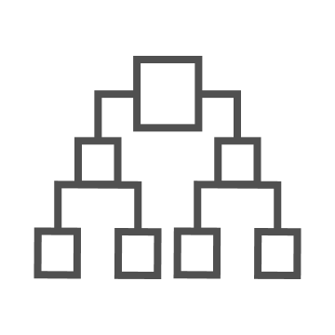
Management Groups
Make environment management easier by grouping subscriptions together
Create a hierarchy of management groups that fit your organization
Apply governance controls with policies and access controls along with other Azure services
Grouping subscriptions into logical groups allow for new organization models
Inheritance allows for single assignment of controls that apply to all subscriptions
Aggregated views above the subscription level
Create a flexible hierarchy that can be updated quickly
Hierarchy doesn’t need to model the organizations billing hierarchy
Can easily scale up or down depending on the organizational needs
Azure Resource Manager (ARM) objects that allow integrations with other Azure services
Azure services:
Azure Policy
RBAC
Azure Cost Management
Azure Blueprints
Azure Security Center
Notes:
Sarah

Slide 72
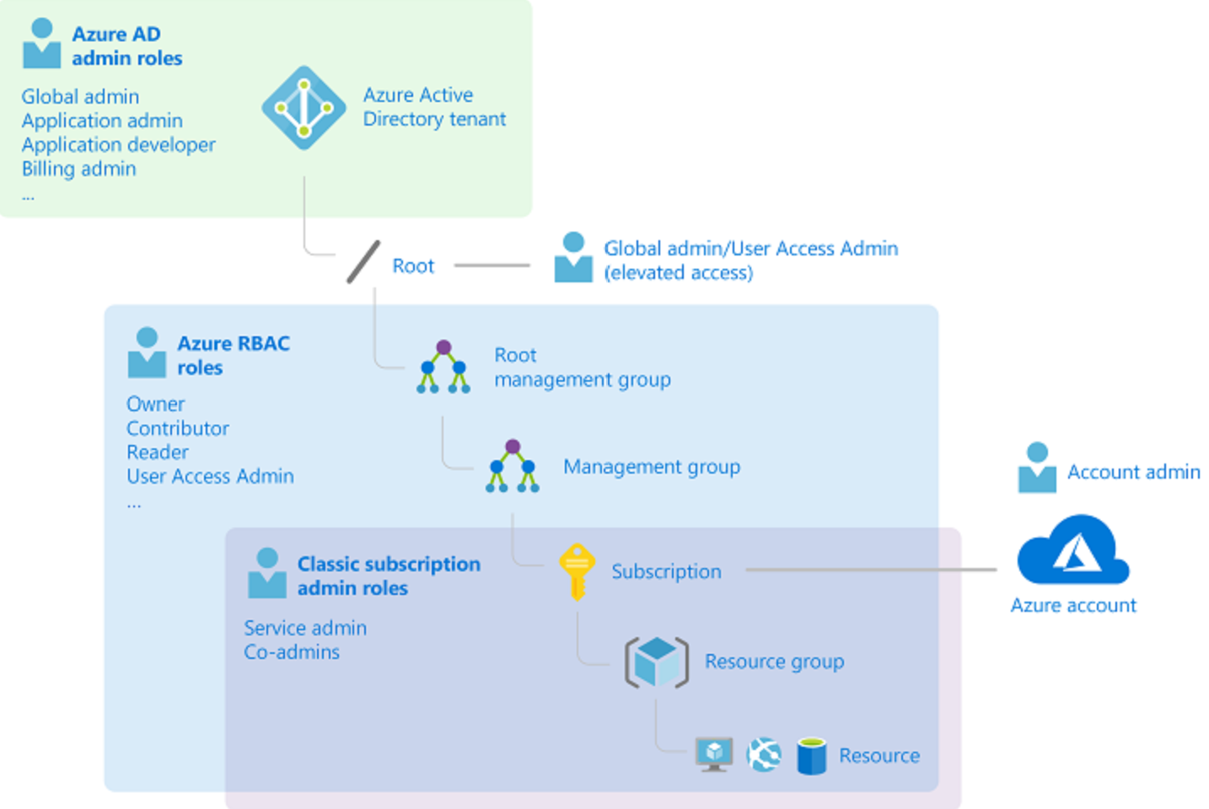
Management Group & Azure Active Directory
aad.portal.azure.com
portal.office.com
portal.azure.com
ea.azure.com
account.azure.com/subscription
portal.azure.com
Notes:
Sarah

Slide 73
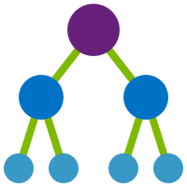


Tags add context without mapping hierarchy to MGs
Finance codes
CostCenter tag, etc.
Application context
AppService tag, etc.
Deployment context
Environment tag, etc.
Who is accountable
BusinessOwner tag, etc.
TAG = !!! ?
Tags should be enforced by configuration policies
Use Azure Policy to set and track ARM tagging policies
MG, Subscription, RG scopes
Enforce that tags exist
Set default values for tags
Audit if tags are missing
!!!
!!!
!!!
!!!
!!!
!!!
!!!
!!!
Notes:
Sarah

Slide 74
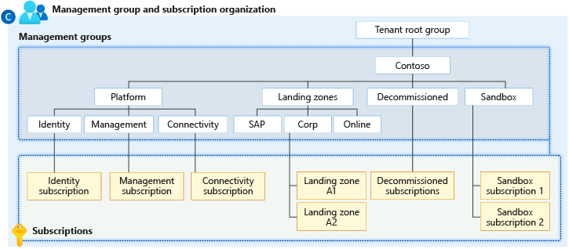
Management Group Hierarchy – Enterprise-Scale
Notes:
Sarah
Wie Sie sehen können soll nicht die Organisationsstruktur wie im Enrollment abgebildet warden
Management Group soll für Policies, nicht für Kostenverrechnung genutzt warden
Workloads mit densemen Sicherheits und compliance anforderungen warden unter einer Management Group gruppoert
Sandbox: Experimente mit Azure sind komplett isoliert in separater Management Group, sodas User sofort die Möglichkeit haben, isoliert Azure zu testen in dem Rahmen der für alle Sandboxes definiert wurde. Dabei können auch Dinge getestet warden, die im Rest der Umgebung zum Beispiel nicht erlaubt sind
Do not repeat yourself, credo für Aufbau der Management Group Umgebung
Regionenspezifische Management Groups möglich

Slide 75
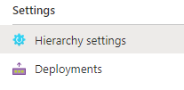
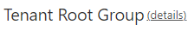
Management Group Hierarchy recommendations and why?
Root: No subscriptions under root, Limited policy assignments dedicated policies for levels underneath
Depth: Flat Management Group Hierarchy – no more that 3 – 4 levels.
Groups based on: workloads & policy Assignment, not billing purposes.
Tags: Query for resources based on tags, don’t search through management group hierarchy
Sandboxes: completely isolated to experiment besides enterprise guardrails
Platform: Dedicated policies and central billing used for central Azure foundation
Access & Management: Elevated access on root only for dedicated Service Principal
New subscriptions: Define default management group for new subscriptions
Notes:
Sarah

Slide 76
Subscription Organization & Governance
Why do we talk about this?
Notes:
Sarah: Warum sprechen wir darüber
Niels:
Subscriptions

Slide 77
Subscription Organization & Governance
Subscription:
Unit of management, billing and scale
Boundary for policies
factors for subscription design are environment type, ownership, governance model and application needs
within workload design keep subscription limits in mind
Notes:
Niels

Slide 78
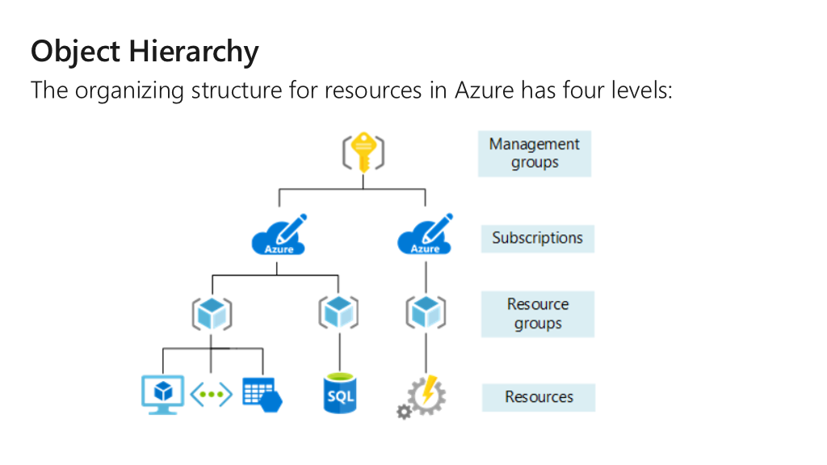
Notes:
Niels
Subscriptions serve as boundaries for assigning Azure policies. For example, secure workloads such as Payment Card Industry (PCI) workloads typically require additional policies to achieve compliance. Instead of using a management group to group workloads that require PCI compliance, you can achieve the same isolation with a subscription. This way, you don't have too many management groups with a small number of subscriptions.

Slide 79
Subscription Organization & Governance
Azure Policy:
guardrails that establish governance model within a specified scope
enforces organizational standards
assess compliance at scale
used for resource consistency, regulatory compliance, security, cost and management
Notes:
Niels

Slide 80

Azure Policy
Turn on built-in policies or build custom ones for all resource types
Apply policies to a Management Group with control across your entire organization
Real time remediation
Real-time policy evaluation and enforcement
Apply multiple policies and & aggregate policy states with policy initiative
Remediation on existing resources
Periodic & on-demand compliance evaluation
Exclusion Scope
VM In-Guest Policy
Enforcement & Compliance
Apply policies at scale
Remediation
Notes:
Niels

Slide 81
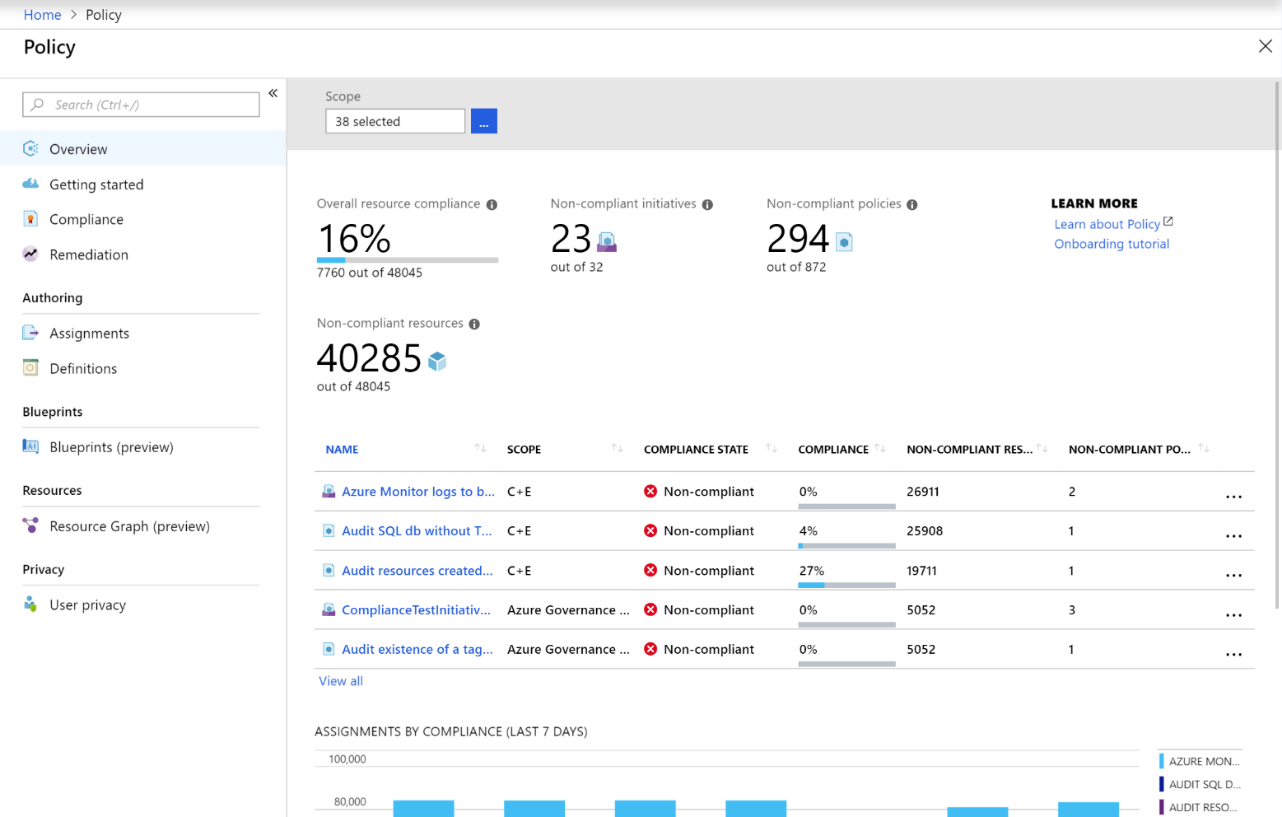
Azure Policy
No other platform can do real time Policy enforcement
No other cloud offers at-scale compliance assessment (and it’s FREE for Azure!)
Policy evaluates all Azure resources & in-guest VM
Policy generate compliance events that can be used for alerting
Aggregated and raw compliance data are available through API, Powershell & CLI
Can be used to automatically remediate problems in your environment

Slide 82
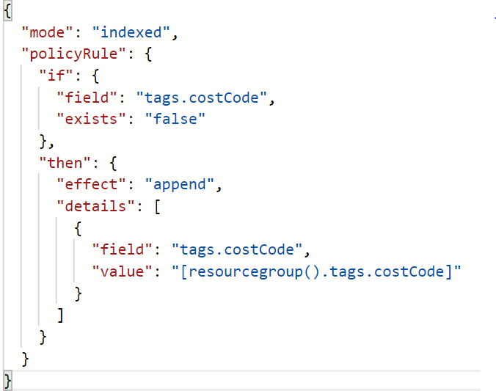
Azure Policy
Restrict location or resource type (built-in)
Inherit tags from Resource Group (see right ->)
Block ‘open to any’ NSG rule creation
Enable diagnostic logs at-scale
Security (built-in from Azure Security Center & In-Guest)

Slide 83
Subscription Organization & Governance recommendations and why?
Put small workloads with the same policy requirement on the same subscription.
Treat subscriptions as a democratized unit of management aligned with business needs and priorities.
Make subscription owners aware of their roles and responsibilities:
Perform an access review in Azure AD Privileged Identity Management quarterly or twice a year to ensure that privileges don't proliferate as users move within the customer organization.
Take full ownership of budget spending and resource utilization.
Ensure policy compliance and remediate when necessary.
Notes:
Niels

Slide 84
Subscription Organization & Governance recommendations and why?
Use the following principles when identifying requirements for new subscriptions
Scale Limits
Management boundary
Policy boundary
Networking Topology
Notes:
Scale limits: Subscriptions serve as a scale unit for component workloads to scale within platform subscription limits. For example, large, specialized workloads such as high-performance computing, IoT, and SAP are all better suited to use separate subscriptions to avoid limits (such as a limit of 50 Azure Data Factory integrations).
Management boundary: Subscriptions provide a management boundary for governance and isolation, which allows for a clear separation of concerns. For example, different environments such as development, test, and production are often isolated from a management perspective.
Policy boundary: Subscriptions serve as a boundary for the assignment of Azure policies. For example, secure workloads such as PCI typically require additional policies to achieve compliance. This additional overhead doesn't need to be considered holistically if a separate subscription is used. Similarly, development environments might have more relaxed policy requirements relative to production environments.
Target network topology: Virtual networks can't be shared across subscriptions, but they can connect with different technologies such as virtual network peering or Azure ExpressRoute. Consider which workloads must communicate with each other when you decide whether a new subscription is required.

Slide 85
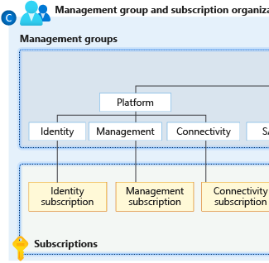
Subscription Organization & Governance recommendations and why?
Group subscriptions together under management groups
Dedicated management subscription in the Platform management group
Dedicated identity subscription in the Platform management group
Dedicated connectivity subscription in the Platform management
Avoid a rigid subscription model - One size doesn't fit all for subscriptions.
Notes:
Group subscriptions together under management groups aligned within the management group structure and policy requirements at scale. Grouping ensures that subscriptions with the same set of policies and Azure role assignments can inherit them from a management group, which avoids duplicate assignments.
Establish a dedicated management subscription in the Platform management group to support global management capabilities such as Azure Monitor Log Analytics workspaces and Azure Automation runbooks.
Establish a dedicated identity subscription in the Platform management group to host Windows Server Active Directory domain controllers, when necessary.
Establish a dedicated connectivity subscription in the Platform management group to host an Azure Virtual WAN hub, private Domain Name System (DNS), ExpressRoute circuit, and other networking resources. A dedicated subscription ensures that all foundation network resources are billed together and isolated from other workloads.
Avoid a rigid subscription model, and opt instead for a set of flexible criteria to group subscriptions across the organization. This flexibility ensures that as your organization's structure and workload composition changes, you can create new subscription groups instead of using a fixed set of existing subscriptions. One size doesn't fit all for subscriptions. What works for one business unit might not work for another. Some applications might coexist within the same landing zone subscription while others might require their own subscription.

Slide 86
Subscription Quota & Capacity
Is there something else I need to consider?
Notes:
Sarah: Warum sprechen wir darüber
Niels:
Subscriptions

Slide 87
Subscription Quota & Capacity
Azure regional capacity:
Finite number of resources within Azure region.
Subscription Quota / Limits:
refers to limitation for resources per region on a subscription.
there are hard and soft limits.
can be increased via support ticket depending on availability and if hard limit is reached.
F.e. when planning an application, check subscription quota and increase them when it exceeds for your workloads.
Notes:
Sarah

Slide 88
Subscription Limits
Resource | Limit
Subscriptions per Azure Active Directory tenant | Unlimited
Resource groups per subscription | 980
Tags per subscription | 50
Unique tag calculations per subscription | 10,000
Subscription-level deployments per location | 800
Number of storage accounts per region per subscription, including standard, and premium storage accounts. | 250
Maximum storage account capacity | 5 PiB
Load balancers | 1,000
VM total cores per subscription for Enterprise Agreement | 350 per region. Contact support to increase limit.
... there are a lot more!
Azure subscription limits and quotas - Azure Resource Manager | Microsoft Docs
Notes:
Sarah
Deployments pro Subscription
Deployment historie löschen nach --- Tagen automatisiert

Slide 89
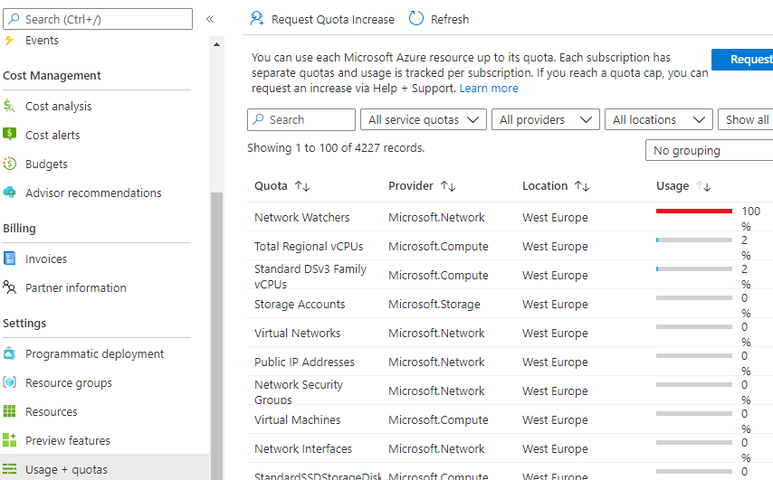
Subscription Quota & Capacity – Usage & Quota in portal
Notes:
Sarah

Slide 90
Subscription Quota & Capacity recommendations and why?
Plan ahead:
Consider limits and quotas per region for each service that your workloads require.
Raise support request for quota increase as part of subscription provisioning.
Consider availability of required service in chosen region.
Use subscription as scale unit:
Ensure that scaling out is possible without hitting subscription limits
Monitor capacity level and setup alerting for capacity utilization.
Notes:
Sarah

Slide 91
Cost Management
How do I handle my budget?
Notes:
Sarah: Warum sprechen wir darüber
Niels:
Subscriptions

Slide 92
Cost Management
Cost transparency across a technical estate is a critical management challenge faced by every large enterprise organization. This section explores key aspects associated with how cost transparency can be achieved across large Azure environments.
Considerations:
Potential need for chargeback models where shared platform as a service (PaaS) resources are concerned, such as Azure App Service Environment and Azure Kubernetes Service, which might need to be shared to achieve higher density.
Use a shutdown schedule for nonproduction workloads to optimize costs.
Use Azure Advisor to check cost optimization recommendations.
Notes:
Niels

Slide 93

Cost Management tools in Azure
The following is a list of Azure native tools that can help mature the policies and processes that support this governance discipline.

Slide 94
Cost Management recommendations and why?
Use Azure Cost Management + Billing for cost aggregation. Make it available to application owners.
Use Azure resource tags for cost categorization and resource grouping. Using tags allows you to have a chargeback mechanism for workloads that share a subscription or for a given workload that spans across multiple subscriptions.
Notes:
Niels

Slide 95
Keep in mind!
Responsibility within Enterprise-Scale: Separate platform from Landing Zones
Do not map organizational hierarchy: Keep management group hierarchy flat!
Groups based on: workloads & policy Assignment, not billing purposes.
Tags: Query for resources based on tags, don’t search through management group hierarchy
Plan ahead: for quotas, availability and cost allocation
Notes:
Sarah:
Kurze Zusammenfassung

